Slide 1
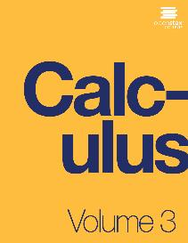

CALCULUS VolUME 3
Chapter 6 VECTOR CALCULUS
PowerPoint Image Slideshow

Slide 2

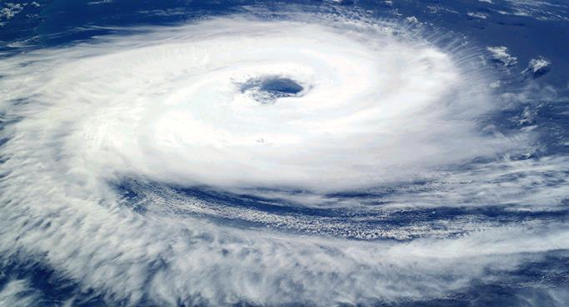
Figure 6.1
Hurricanes form from rotating winds driven by warm temperatures over the ocean. Meteorologists forecast the motion of hurricanes by studying the rotating vector fields of their wind velocity. Shown is Cyclone Catarina in the South Atlantic Ocean in 2004, as seen from the International Space Station. (credit: modification of work by NASA)

Slide 3
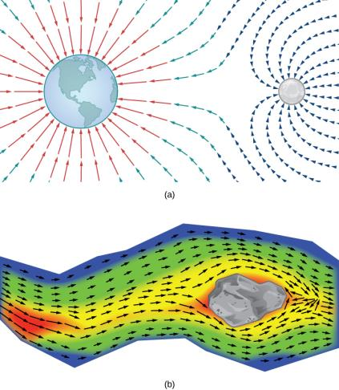
Figure 6.2
The gravitational field exerted by two astronomical bodies on a small object.
The vector velocity field of water on the surface of a river shows the varied speeds of water. Red indicates that the magnitude of the vector is greater, so the water flows more quickly; blue indicates a lesser magnitude and a slower speed of water flow.

Slide 4
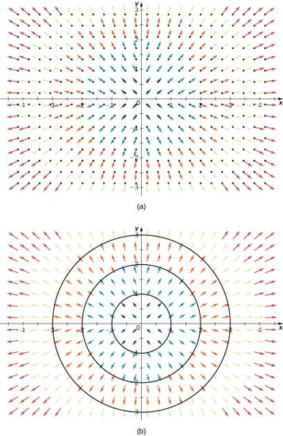
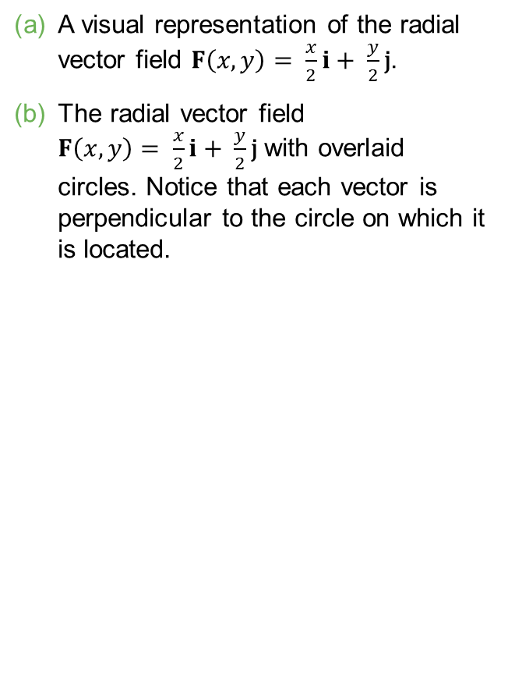
Figure 6.3
A visual representation of the radial vector field $F\left(x, y\right)= \frac{x}{2}i+ \frac{y}{2}\text{j}$.
The radial vector field $F\left(x, y\right)= \frac{x}{2}i+ \frac{y}{2}\text{j}$ with overlaid circles. Notice that each vector is perpendicular to the circle on which it is located.

Slide 5
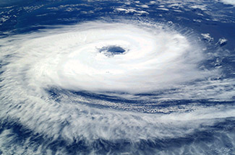
Figure 6.4
(credit: modification of work by NASA)

Slide 6
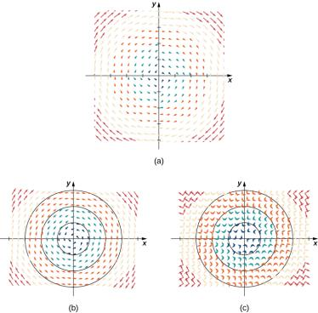
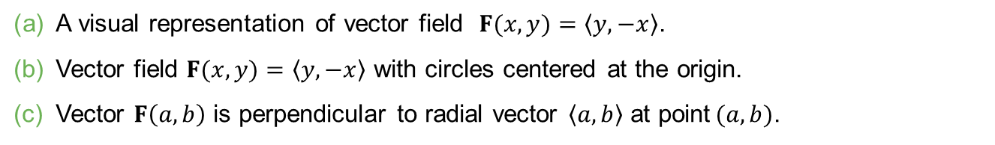
Figure 6.5
A visual representation of vector field $F(x, y)=\left\langle y, −x\right\rangle$.
Vector field $F(x, y)=\left\langle y, −x\right\rangle$ with circles centered at the origin.
Vector $F\left(a, b\right)$ is perpendicular to radial vector $\left\langle a, b\right\rangle$ at point$(a, b)$.

Slide 7
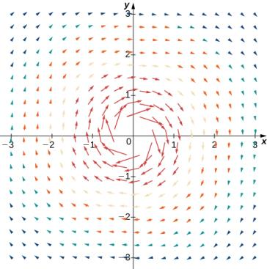
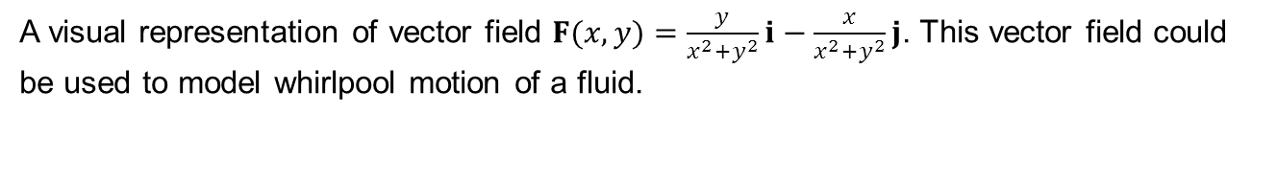
Figure 6.6
A visual representation of vector field $F(x, y)=\frac{y}{x^{2}+y^{2}}i−\frac{x}{x^{2}+y^{2}}j$. This vector field could be used to model whirlpool motion of a fluid.

Slide 8
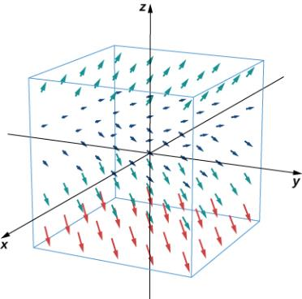
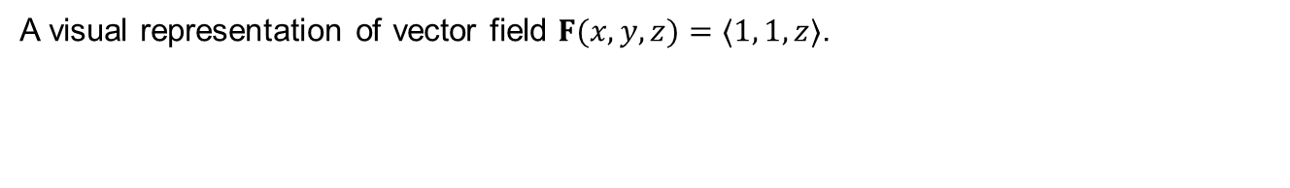
Figure 6.7
A visual representation of vector field $F(x, y, z)=〈1, 1, z〉$.

Slide 9
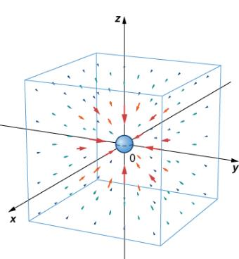
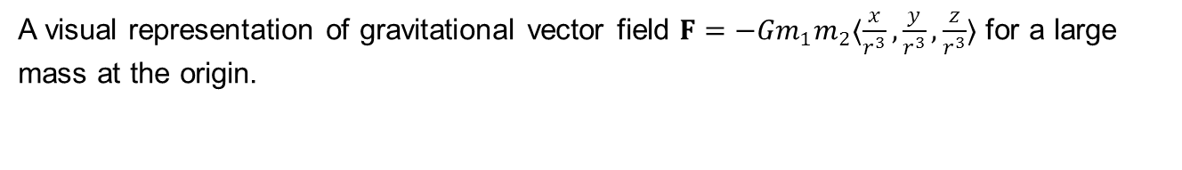
Figure 6.8
A visual representation of gravitational vector field $F=−{Gm}_{1}m_{2}〈\frac{x}{r^{3}},\frac{y}{r^{3}},\frac{z}{r^{3}}〉$ for a large mass at the origin.

Slide 10
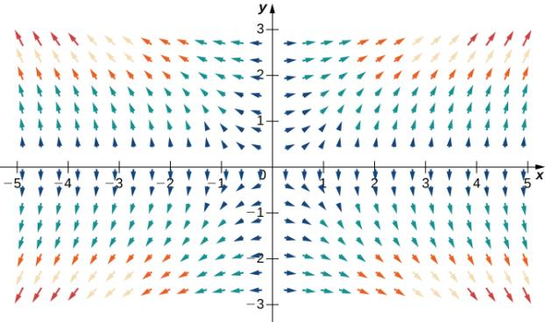
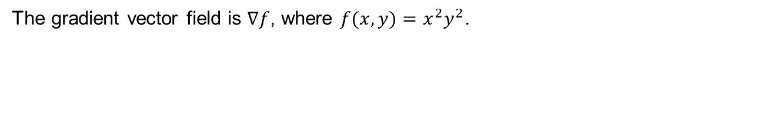
Figure 6.9
The gradient vector field is $∇f$, where $f(x, y)=x^{2}y^{2}$.

Slide 11
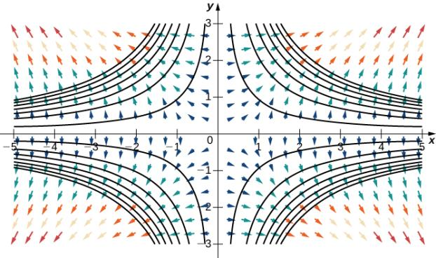
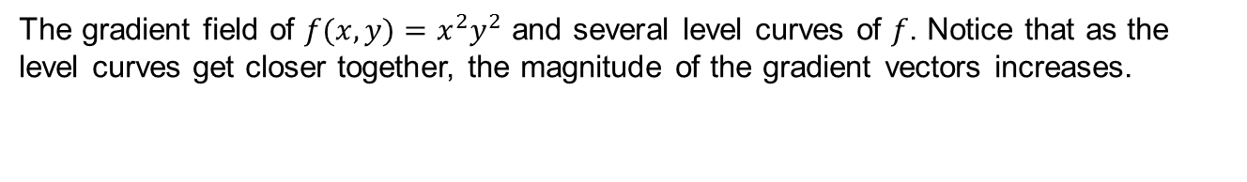
Figure 6.10
The gradient field of $f(x, y)=x^{2}y^{2}$ and several level curves of $f$. Notice that as the level curves get closer together, the magnitude of the gradient vectors increases.

Slide 12
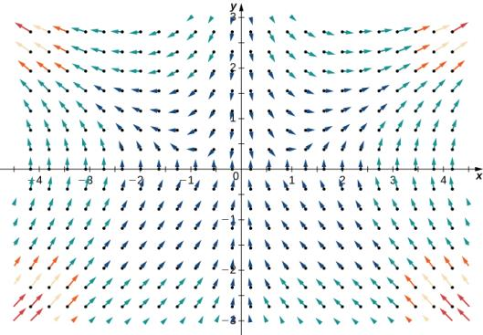
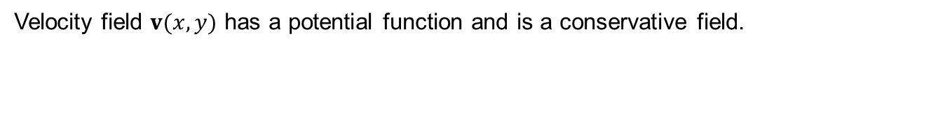
Figure 6.11
Velocity field $v(x, y)$ has a potential function and is a conservative field.

Slide 13
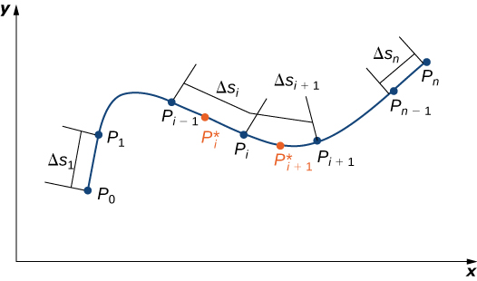
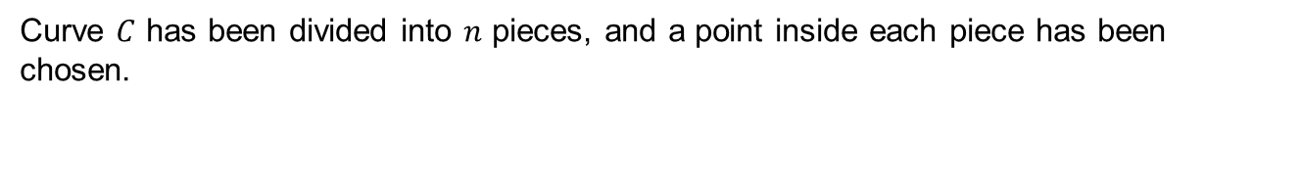
Figure 6.12
Curve $C$ has been divided into $n$ pieces, and a point inside each piece has been chosen.

Slide 14
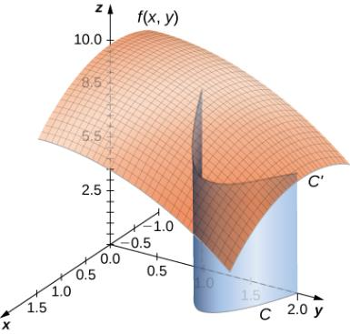
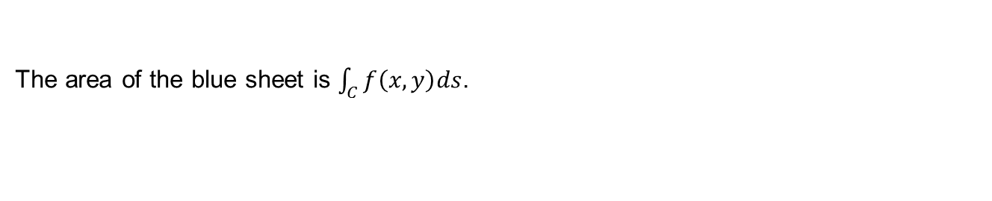
Figure 6.13
The area of the blue sheet is $\int_{C}{f\left(x, y\right)ds}$.

Slide 15
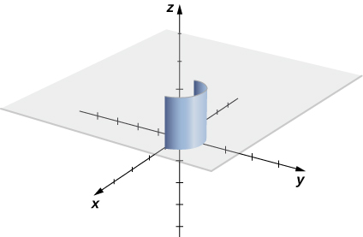
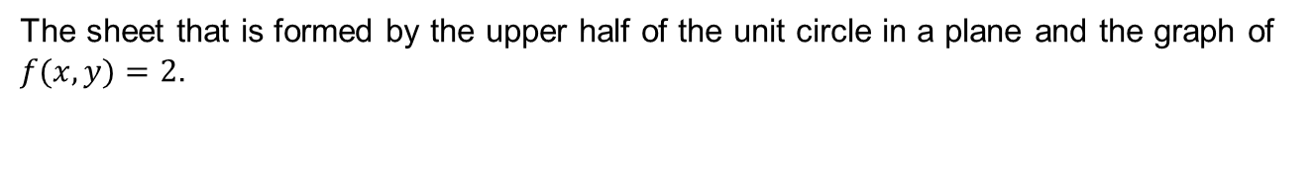
Figure 6.14
The sheet that is formed by the upper half of the unit circle in a plane and the graph of $f(x, y)=2$.

Slide 16
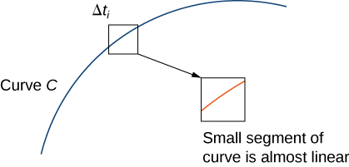
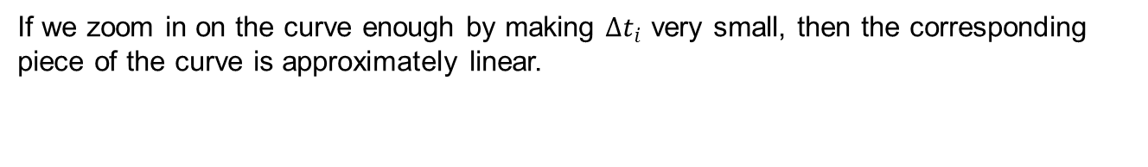
Figure 6.15
If we zoom in on the curve enough by making $Δt_{i}$ very small, then the corresponding piece of the curve is approximately linear.

Slide 17
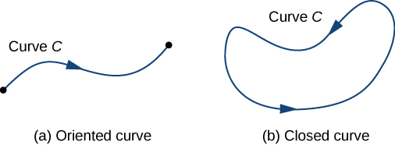
Figure 6.16
An oriented curve between two points.
A closed oriented curve.

Slide 18
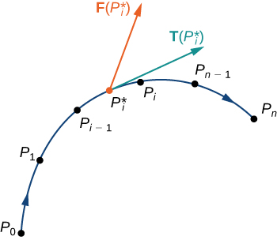
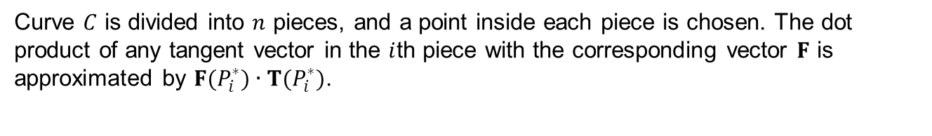
Figure 6.17
Curve $C$ is divided into $n$ pieces, and a point inside each piece is chosen. The dot product of any tangent vector in the $i$th piece with the corresponding vector $F$ is approximated by $F(P_{i}^{∗})∙T(P_{i}^{∗})$.

Slide 19
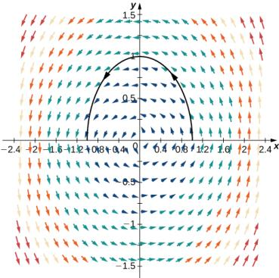
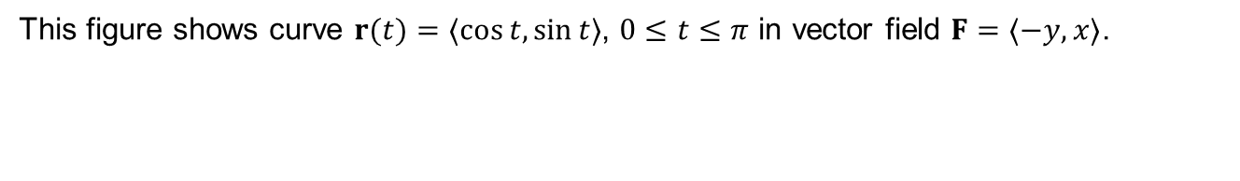
Figure 6.18
This figure shows curve $r(t)=〈cos⁡t, sin⁡t〉$, $0≤t≤π$ in vector field $F=〈−y, x〉$.

Slide 20
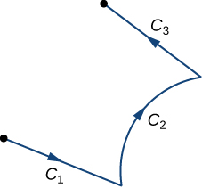
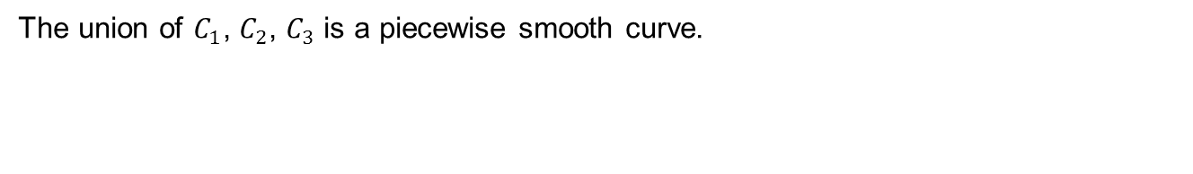
Figure 6.19
The union of $C_{1}$, $C_{2}$, $C_{3}$ is a piecewise smooth curve.

Slide 21
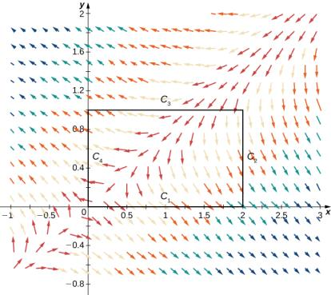
Figure 6.20
Rectangle and vector field for Example 6.21.

Slide 22
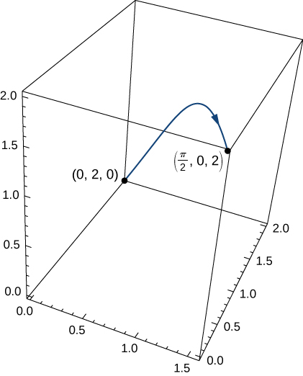
Figure 6.21
The wire from Example 6.22.

Slide 23
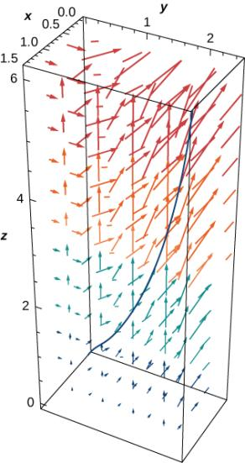
Figure 6.22
The curve and vector field for Example 6.23.

Slide 24
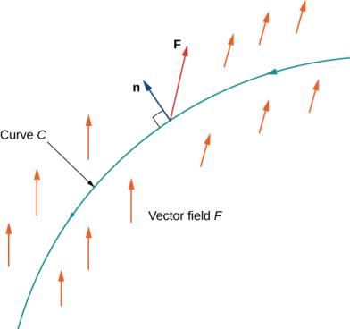
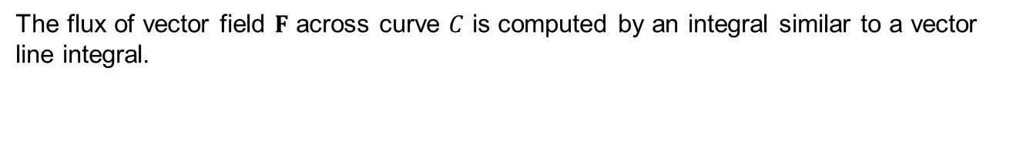
Figure 6.23
The flux of vector field $F$ across curve $C$ is computed by an integral similar to a vector line integral.

Slide 25
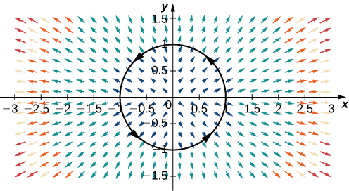
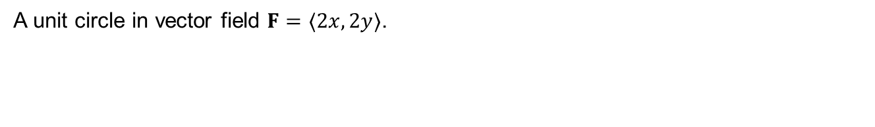
Figure 6.24
A unit circle in vector field $F=〈2x, 2y〉$.

Slide 26
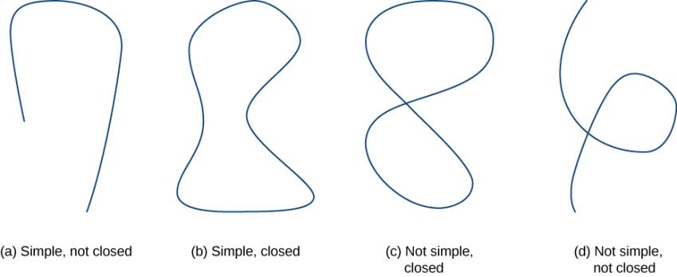
Figure 6.25
Types of curves that are simple or not simple and closed or not closed.

Slide 27
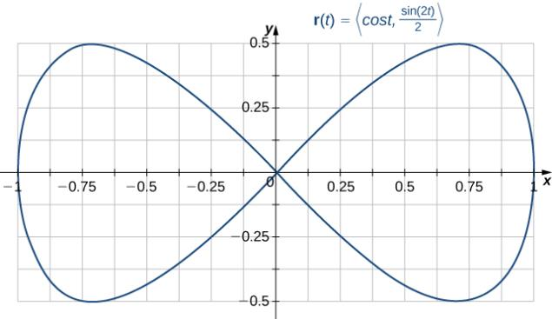
Figure 6.26
A curve that is closed but not simple.

Slide 28
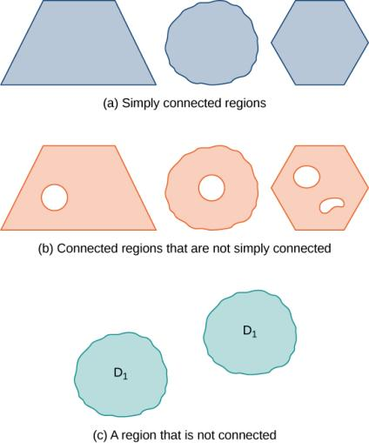
Figure 6.27
Not all connected regions are simply connected. (a) Simply connected regions have no holes. (b) Connected regions that are not simply connected may have holes but you can still find a path in the region between any two points. (c) A region that is not connected has some points that cannot be connected by a path in the region.

Slide 29
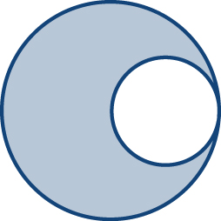

Slide 30
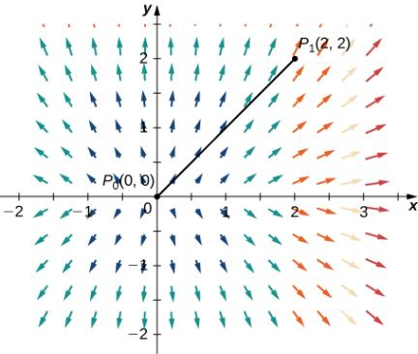
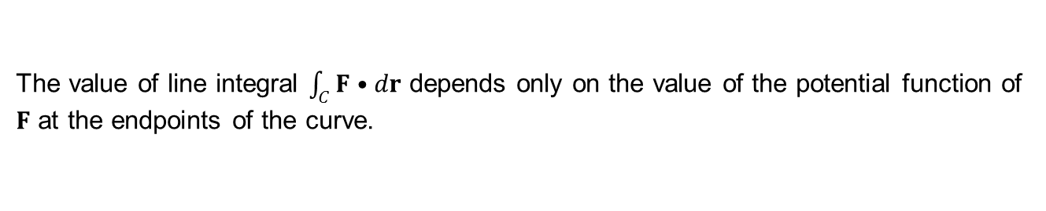
Figure 6.28
The value of line integral $\int_{C}{F•dr}$ depends only on the value of the potential function of $F$ at the endpoints of the curve.

Slide 31
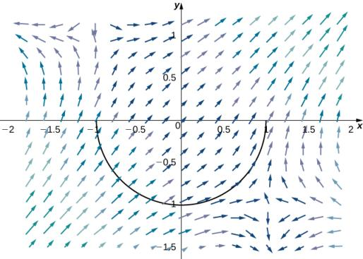

Slide 32
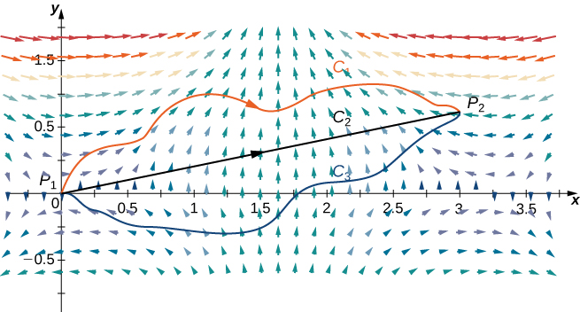
Figure 6.29
The vector field is conservative, and therefore independent of path.

Slide 33


Figure 6.30
Here, $C_{1}$ is any path from $C$ to $\left(a, y\right)$ that stays inside $D$, and $C_{2}$ is the horizontal line segment from $(a, y)$ to $(x, y)$.

Slide 34


Figure 6.31
Curves $C_{1}$ and $C_{2}$ are both oriented from left to right.

Slide 35


Figure 6.32
The Fundamental Theorem of Calculus says that the integral over line segment $[a, b]$ depends only on the values of the antiderivative at the endpoints of $[a, b]$.

Slide 36


Figure 6.33
The circulation form of Green’s theorem relates a line integral over curve $C$ to a double integral over region $D$.

Slide 37


Figure 6.34
Rectangle $D$ is oriented counterclockwise.

Slide 38

Figure 6.35
The line integral over the boundary of the rectangle can be transformed into a double integral over the rectangle.

Slide 39

Figure 6.36
The line integral over the boundary circle can be transformed into a double integral over the disk enclosed by the circle.

Slide 40


Figure 6.37
Ellipse $\frac{x^{2}}{a^{2}}+\frac{y^{2}}{b^{2}}=1$ is denoted by $C$.

Slide 41


Slide 42


Figure 6.38
The flux form of Green’s theorem relates a double integral over region $D$ to the flux across curve $C$.

Slide 43


Figure 6.39
Curve $C$ is a circle of radius $r$ centered at the origin.

Slide 44


Figure 6.40
Curve $S$ is a triangle with vertices (0, 0), (1, 0), and (0, 3) oriented clockwise.

Slide 45

Figure 6.41
Water flows across the rectangle with vertices (−1, −2), (1, −2), (1, 3), and (−1, 3), oriented counterclockwise.

Slide 46


Figure 6.42
In this image, we see the three-level curves of $g$ and vector field $F$. Note that the $F$ vectors on a given level curve are tangent to the level curve.
In this image, we see the three-level curves of $g$ and vector field $∇g$. The gradient vectors are perpendicular to the corresponding level curve. Therefore, $F(a, b)•∇g(a, b)=0$ for any point in the domain of $g$.

Slide 47

Figure 6.43
Green’s theorem, as stated, does not apply to a nonsimply connected region with three holes like this one.

Slide 48


Figure 6.44
Region $D$ with an oriented boundary has three holes.
Region $D$ split into two simply connected regions has no holes.

Slide 49

Figure 6.45
Breaking the annulus into two separate regions gives us two simply connected regions. The line integrals over the common boundaries cancel out.

Slide 50


Figure 6.46
Choose circle $C_{1}$ centered at the origin that is contained entirely inside $C$.

Slide 51

Figure 6.47
This magnetic resonance image of a patient’s brain shows a tumor, which is highlighted in red. (credit: modification of work by Christaras A, Wikimedia Commons)

Slide 52

Figure 6.48
A rolling planimeter. The pivot allows the tracer arm to rotate. The roller itself does not rotate; it only moves back and forth.
An interior view of a rolling planimeter. Notice that the wheel cannot turn if the planimeter is moving back and forth with the tracer arm perpendicular to the roller.

Slide 53

Figure 6.49
Mathematical analysis of the motion of the planimeter.

Slide 54


Figure 6.50
Vector field $〈1, 2〉$ has zero divergence.
Vector field $〈−y, x〉$ also has zero divergence.

Slide 55

Figure 6.51
This vector field has negative divergence.

Slide 56


Figure 6.52
The divergence of vector field $F(x, y)=〈x^{2}y, y−xy^{2}〉$ is one, so it cannot model a magnetic field.

Slide 57


Figure 6.53
Vector field $v(x, y)=〈−xy, y〉$ has negative divergence at (1, 4).

Slide 58

Figure 6.54
To visualize curl at a point, imagine placing a small paddlewheel into the vector field at a point.

Slide 59


Figure 6.55
Vector field $F(x, y)=〈y, 0〉$ consists of vectors that are all parallel.

Slide 60


Figure 6.56
The curl of vector field $F\left(x, y, z\right)=〈yz, xz, xy〉$ is zero.

Slide 61


Figure 6.57
Lines $\left\langle cos K,\sin{K, v}\right\rangle$ for $K=0, \frac{π}{2}, π,$ and $\frac{3π}{2}$.
Circles $\left\langle cos u,\sin{u, K}\right\rangle$ for $K=−2, −1, 1,$ and $2$.
The lines and circles together. As $u$ and $v$ vary, they describe a cylinder.

Slide 62


Figure 6.58
Cylinder $x^{2}+y^{2}=r^{2}$ has parameterization $r\left(u, v\right)=〈r\cos{u}, r\sin{u}, v〉$, $0≤u≤2π$, $−∞<v<∞$.

Slide 63


Figure 6.59
Circles arise from holding $u$ constant; the vertical parabolas arise from holding $v$ constant.
An elliptic paraboloid results from all choices of $u$ and $v$ in the parameter domain.

Slide 64


Figure 6.60
Cone $x^{2}+y^{2}=z^{2}$ has parameterization $r\left(u, v\right)=〈u\cos{v}, u\sin{v}〉$, $−∞<u<∞$, $0≤v≤2π$.

Slide 65


Figure 6.61
The sphere of radius $ρ$ has parameterization $r\left(φ, θ\right)=〈ρ\cos{θ}\sin{φ, }ρ\sin{θ}\sin{φ, }ρ\cos{φ}〉$, $0≤θ≤2π, 0≤φ≤π$.

Slide 66


Figure 6.62
The simplest parameterization of the graph of a function is $r\left(x, y\right)=〈x, y, f\left(x, y\right)〉$.

Slide 67


Figure 6.63
The image of parameterization $r\left(u, v\right)=\left\langle 0, cos v, 1\right\rangle \text{,}$ $0≤u≤1, 0≤v≤π$ is a line.

Slide 68

Figure 6.64
This surface is smooth.
This surface is piecewise smooth.

Slide 69

Figure 6.65
Grid lines on a parameter domain correspond to grid curves on a surface.

Slide 70


Figure 6.66
If the cross product of vectors $t_{u}$ and $t_{v}$ exists, then there is a tangent plane.

Slide 71


Figure 6.67
The parallelogram spanned by $t_{u}$ and $t_{v}$ approximates the piece of surface $S_{ij}$.

Slide 72


Figure 6.68
The right circular cone with radius $r=kh$ and height $h$ has parameterization $s\left(u, v\right)=〈kv\cos{u}, kv\sin{u}, v〉\text{,}$ $0≤u<2π$, $0≤v≤h$.

Slide 73


Figure 6.69
We can parameterize a surface of revolution by $r\left(x, θ\right)=〈x,f\left(x\right)\cos{θ, }f\left(x\right)\sin{θ}〉$, $a≤x≤b$, $0≤x<2π$.

Slide 74

Figure 6.70
A surface integral can be used to calculate the surface area of this solid of revolution.

Slide 75


Figure 6.71
Integrating function $f(x, y, z)=x+y^{2}$ over a cylinder.

Slide 76


Figure 6.72
Calculating a surface integral over surface $S$.

Slide 77


Figure 6.73
The maximum value of $φ$ has a tangent value of $\sqrt{3}$.

Slide 78

Figure 6.74
An oriented sphere with positive orientation.

Slide 79

Figure 6.75
If all the vectors normal to a cylinder point outward, then this is an outward orientation of the cylinder.

Slide 80

Figure 6.76
The construction of a Möbius strip.

Slide 81


Figure 6.77
Fluid flows across a completely permeable surface $S$.

Slide 82


Figure 6.78
The mass of fluid per unit time flowing across $S_{ij}$ in the direction of $N$ can be approximated by $(ρv∙N)∆S_{ij}$.

Slide 83

Figure 6.79
Stokes’ theorem relates the flux integral over the surface to a line integral around the boundary of the surface. Note that the orientation of the curve is positive.

Slide 84

Figure 6.80
Chop the surface into small pieces. The pieces should be small enough that they can be approximated by a square.

Slide 85


Figure 6.81
The line integral along $E_{l}$ cancels out the line integral along $F_{r}$ because $E_{l}=−F_{r}$.
The line integral along any of the sides of $E$ cancels out with the line integral along a side of an adjacent approximating square.

Slide 86


Figure 6.82
$D$ is the “shadow,” or projection, of $S$ in the plane and $C′$ is the projection of $C$.

Slide 87

Figure 6.83
Verifying Stokes’ theorem for a hemisphere in a vector field.

Slide 88

Figure 6.84
A complicated surface in a vector field.

Slide 89


Slide 90


Figure 6.85
Disk $D_{r}$ is a small disk in a continuous vector field.

Slide 91

Figure 6.86
To visualize curl at a point, imagine placing a tiny paddlewheel at that point in the vector field.

Slide 92


Figure 6.87
The divergence theorem relates a flux integral across a closed surface $S$ to a triple integral over solid $E$ enclosed by the surface.

Slide 93


Figure 6.88
A small box $B$ inside surface $E$ has sides parallel to the coordinate planes.
Box $B$ has side lengths $Δx$, $Δy$, and $Δz$
If we look at the side view of $B$, we see that, since $(x, y, z)$ is the center of the box, to get to the top of the box we must travel a vertical distance of $Δz/2$ up from $(x, y, z)$. Similarly, to get to the bottom of the box we must travel a distance $Δz/2$ down from $(x, y, z)$.

Slide 94


Slide 95


Figure 6.89
Ball $B_{r}$ of small radius $r$ centered at $P$.

Slide 96


Slide 97


Figure 6.90
Vector field $v=〈−\frac{y}{z}, \frac{x}{z}, 0〉$.

Slide 98


Slide 99
This OpenStax ancillary resource is © Rice University under a CC BY-NC-SA 4.0 International license; it may be reproduced or modified for noncommercial purposes only but must be attributed to OpenStax, Rice University and any changes must be noted. Any adaptation must be shared under the same type of license.

